Slide 1
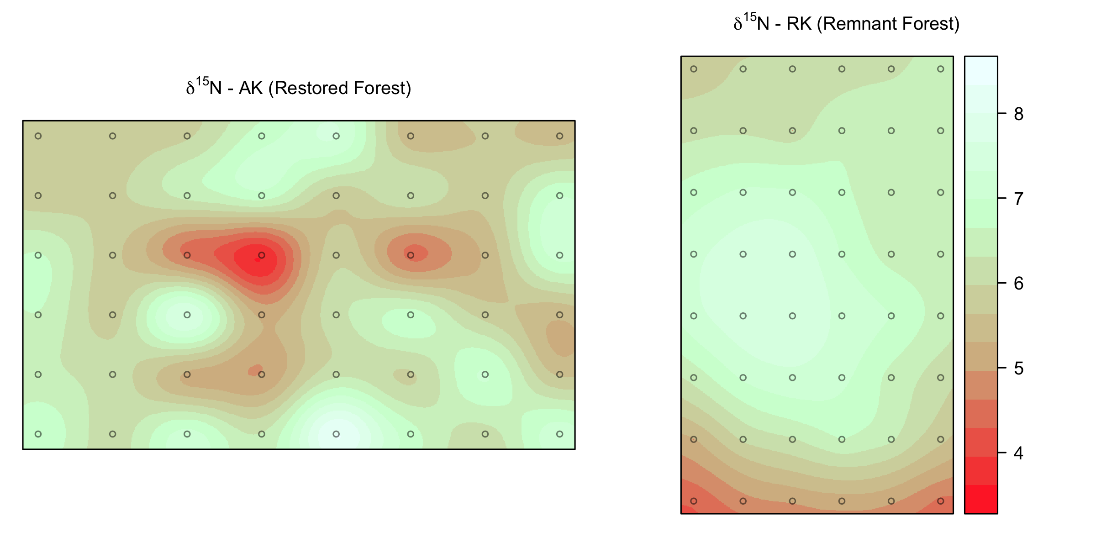
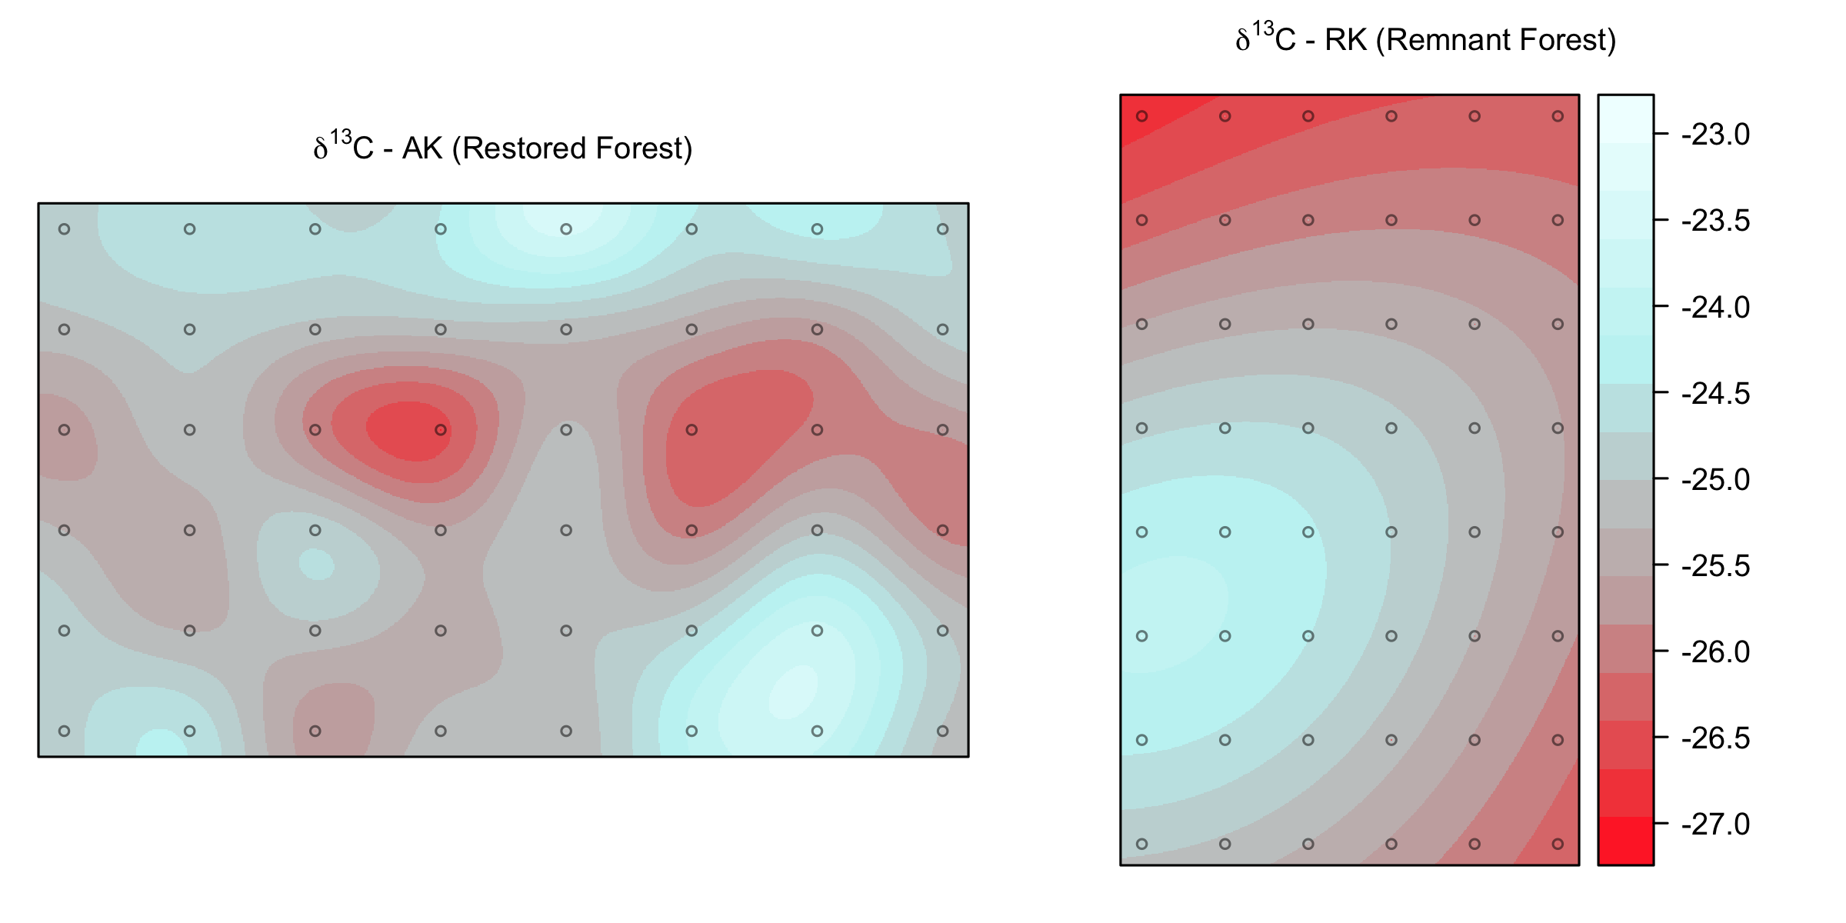
A
Soil nitrogen isoscape
C
Soil carbon isoscape
Koa Plantation (KP)
B
D
Remnant Forest (RK)
δ¹⁵N ‰
δ¹³C ‰
5 m
soil samples
N

